Slide 1
IT305 Week 13_Lec 2 Computer Networks
CSMA and ARP

Slide 2
CSMA (carrier sense multiple access)
simple CSMA: listen before transmit:
if channel sensed idle: transmit entire frame
if channel sensed busy: defer transmission
CSMA/CD: CSMA with collision detection
collisions detected within short time
colliding transmissions aborted, reducing channel wastage
collision detection easy in wired, difficult with wireless

Slide 3
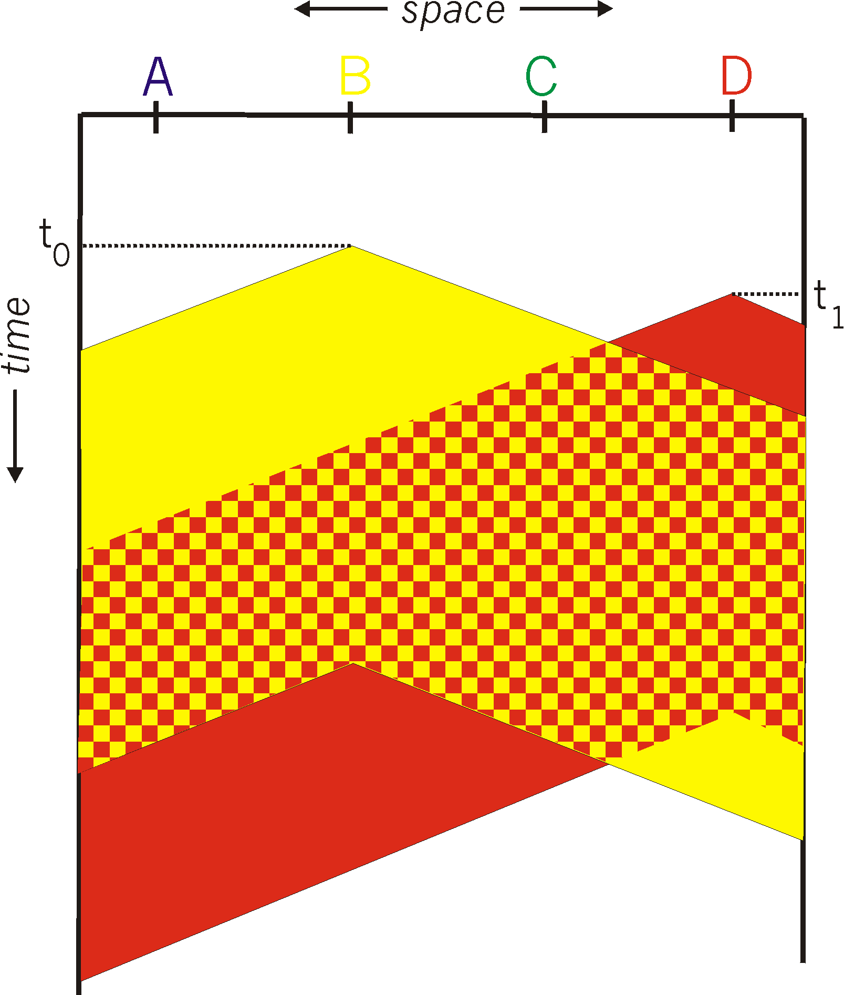

CSMA: collisions
spatial layout of nodes
collisions can still occur with carrier sensing:
propagation delay means two nodes may not hear each other’s just-started transmission
collision: entire packet transmission time wasted
distance & propagation delay play role in in determining collision probability

Slide 4
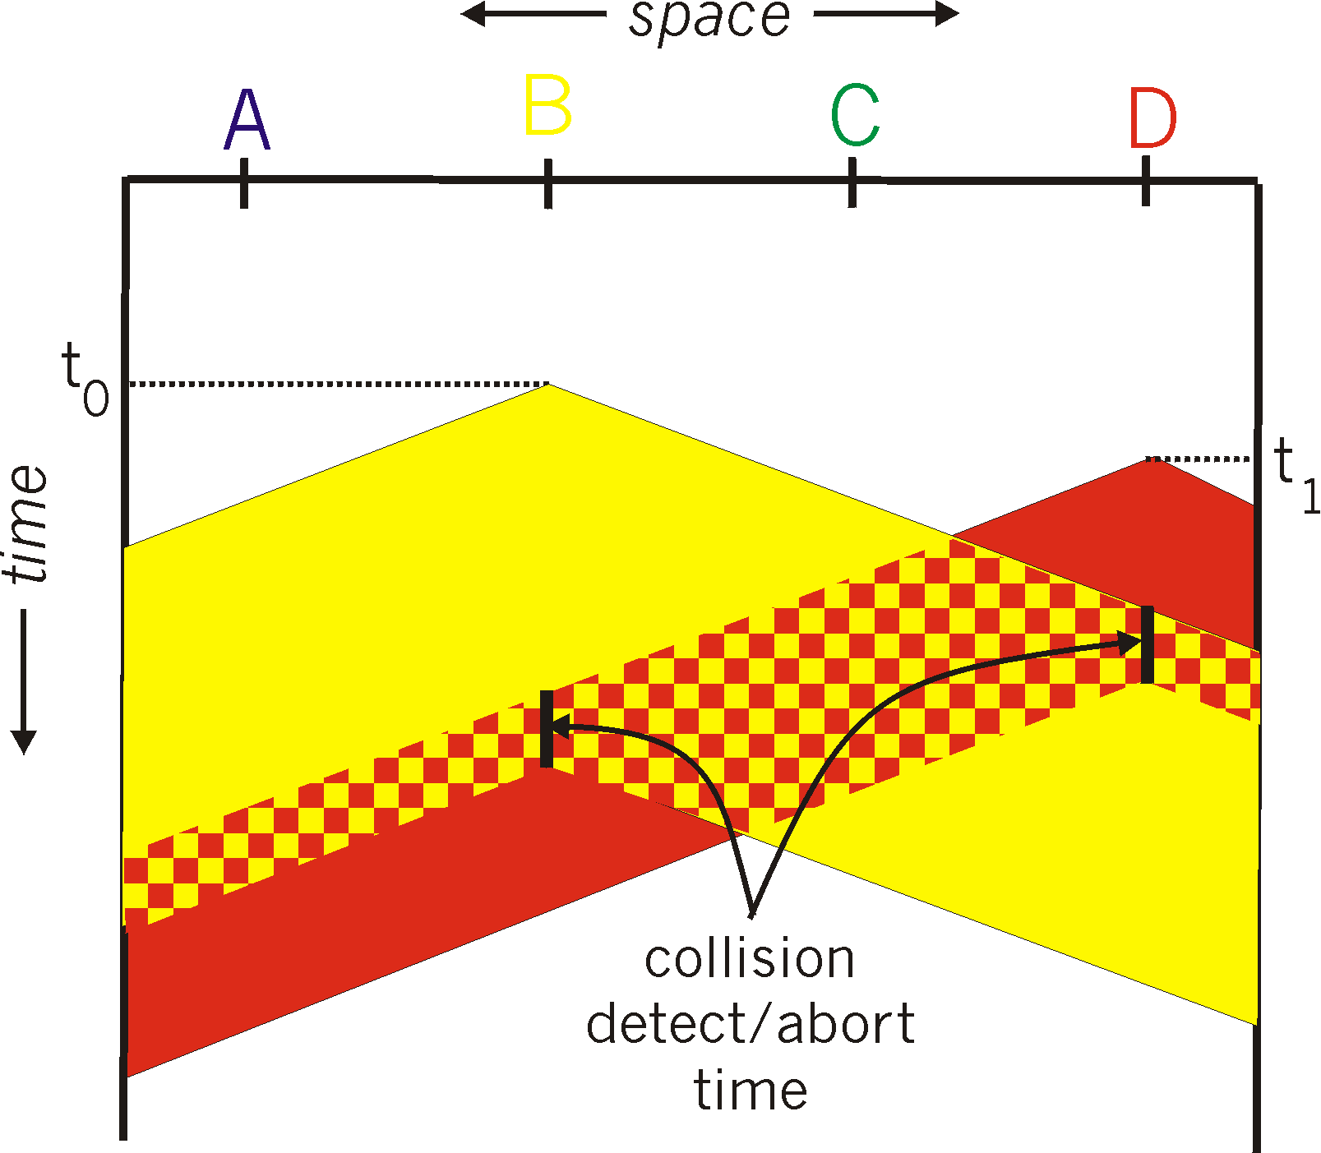
CSMA/CD:
spatial layout of nodes
CSMA/CD reduces the amount of time wasted in collisions
transmission aborted on collision detection

Slide 5
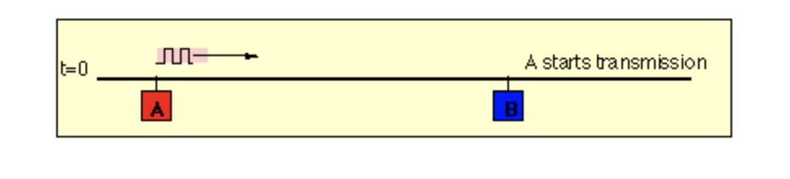
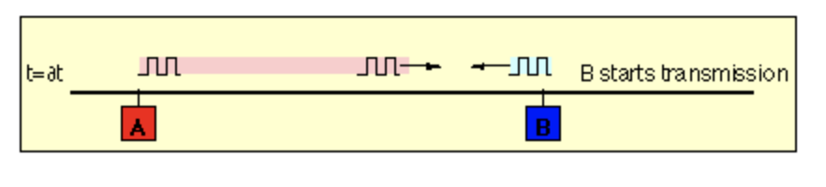
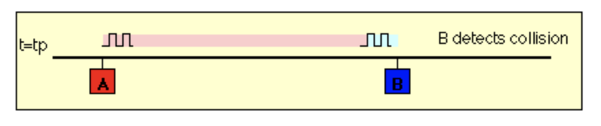
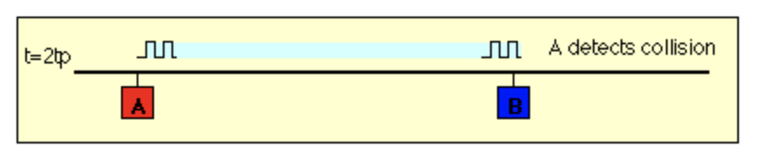

Slide 6
Ethernet CSMA/CD algorithm
Ethernet receives datagram from network layer, creates frame
If Ethernet senses channel:
if idle: start frame transmission.
if busy: wait until channel idle, then transmit
If entire frame transmitted without collision - done!
If another transmission detected while sending: abort, send jam signal
After aborting, enter binary (exponential) backoff:
after mth collision, chooses K at random from {0,1,2, …, 2^{m}-1}. Ethernet waits K·51.2 micro secs, returns to Step 2
more collisions: longer backoff interval
Notes:
For Ethernet, the actual amount of time a node waits is K # 512 bit times (i.e., K times the amount of time needed to send 512 bits into the Ethernet) and the maxi- mum value that n can take is capped at 10.

Slide 7
K = 0, immediate transmission
k=1, wait 512 bit times
2nd collision, K={0, 1, 2,3}, This corresponds to a wait selected from {0, 51.2, 102.4, 153.6} micro seconds.

Slide 8

ARP: address resolution protocol
Question: how to determine interface’s MAC address, knowing its IP address?
ARP table: each IP node (host, router) on LAN has table
ARP
137.196.7.78
IP/MAC address mappings for some LAN nodes:
< IP address; MAC address; TTL>
TTL (Time To Live): time after which address mapping will be forgotten (typically 20 min)
1A-2F-BB-76-09-AD
ARP
ARP
LAN
71-65-F7-2B-08-53
58-23-D7-FA-20-B0
137.196.7.23
137.196.7.14
ARP
0C-C4-11-6F-E3-98
137.196.7.88

Slide 9
ARP protocol in action
example: A wants to send datagram to B
B’s MAC address not in A’s ARP table, so A uses ARP to find B’s MAC address
A broadcasts ARP query, containing B's IP addr
destination MAC address = FF-FF-FF-FF-FF-FF
all nodes on LAN receive ARP query
1
Ethernet frame (sent to FF-FF-FF-FF-FF-FF)
C
Source MAC: 71-65-F7-2B-08-53
Source IP: 137.196.7.23
Target IP address: 137.196.7.14
…
ARP table in A
IP addr
MAC addr
TTL
TTL
A
B
1
71-65-F7-2B-08-53
58-23-D7-FA-20-B0
137.196.7.23
137.196.7.14
D

Slide 10
ARP protocol in action
example: A wants to send datagram to B
B’s MAC address not in A’s ARP table, so A uses ARP to find B’s MAC address
ARP message into Ethernet frame (sent to 71-65-F7-2B-08-53)
C
Target IP address: 137.196.7.14
Target MAC address:
58-23-D7-FA-20-B0
…
ARP table in A
IP addr
MAC addr
TTL
TTL
A
B
2
71-65-F7-2B-08-53
58-23-D7-FA-20-B0
137.196.7.23
137.196.7.14
2
B replies to A with ARP response, giving its MAC address
D

Slide 11
ARP protocol in action
example: A wants to send datagram to B
B’s MAC address not in A’s ARP table, so A uses ARP to find B’s MAC address
C
ARP table in A
IP addr
MAC addr
TTL
TTL
A
B
137.196.
7.14
58-23-D7-FA-20-B0
500
71-65-F7-2B-08-53
58-23-D7-FA-20-B0
137.196.7.23
137.196.7.14
3
A receives B’s reply, adds B entry into its local ARP table
D

Slide 12

Routing to another subnet: addressing
walkthrough: sending a datagram from A to B via R
focus on addressing – at IP (datagram) and MAC layer (frame) levels
assume that:
A knows B’s IP address
A knows IP address of first hop router, R (how?)
A knows R’s MAC address (how?)
A
R
B
111.111.111.111
74-29-9C-E8-FF-55
222.222.222.222
49-BD-D2-C7-56-2A
222.222.222.220
1A-23-F9-CD-06-9B
111.111.111.112
111.111.111.110
CC-49-DE-D0-AB-7D
E6-E9-00-17-BB-4B
222.222.222.221
88-B2-2F-54-1A-0F

Slide 13
Routing to another subnet: addressing
A creates IP datagram with IP source A, destination B
A creates link-layer frame containing A-to-B IP datagram
R's MAC address is frame’s destination
MAC src: 74-29-9C-E8-FF-55
MAC dest: E6-E9-00-17-BB-4B
IP
Eth
Phy
IP src: 111.111.111.111
IP dest: 222.222.222.222
A
R
B
111.111.111.111
74-29-9C-E8-FF-55
222.222.222.222
49-BD-D2-C7-56-2A
222.222.222.220
1A-23-F9-CD-06-9B
111.111.111.112
111.111.111.110
CC-49-DE-D0-AB-7D
E6-E9-00-17-BB-4B
222.222.222.221
88-B2-2F-54-1A-0F

Slide 14
Routing to another subnet: addressing
frame sent from A to R
frame received at R, datagram removed, passed up to IP
MAC src: 74-29-9C-E8-FF-55
MAC dest: E6-E9-00-17-BB-4B
IP src: 111.111.111.111
IP dest: 222.222.222.222
IP
Eth
Phy
IP src: 111.111.111.111
IP dest: 222.222.222.222
IP
Eth
Phy
A
R
B
111.111.111.111
74-29-9C-E8-FF-55
222.222.222.222
49-BD-D2-C7-56-2A
222.222.222.220
1A-23-F9-CD-06-9B
111.111.111.112
111.111.111.110
CC-49-DE-D0-AB-7D
E6-E9-00-17-BB-4B
222.222.222.221
88-B2-2F-54-1A-0F

Slide 15
Routing to another subnet: addressing
R determines outgoing interface, passes datagram with IP source A, destination B to link layer
R creates link-layer frame containing A-to-B IP datagram. Frame destination address: B's MAC address
MAC src: 1A-23-F9-CD-06-9B
MAC dest: 49-BD-D2-C7-56-2A
IP
Eth
Phy
IP src: 111.111.111.111
IP dest: 222.222.222.222
A
R
B
111.111.111.111
74-29-9C-E8-FF-55
222.222.222.222
49-BD-D2-C7-56-2A
222.222.222.220
1A-23-F9-CD-06-9B
111.111.111.112
111.111.111.110
CC-49-DE-D0-AB-7D
E6-E9-00-17-BB-4B
222.222.222.221
88-B2-2F-54-1A-0F

Slide 16
Routing to another subnet: addressing
R determines outgoing interface, passes datagram with IP source A, destination B to link layer
R creates link-layer frame containing A-to-B IP datagram. Frame destination address: B's MAC address
MAC src: 1A-23-F9-CD-06-9B
MAC dest: 49-BD-D2-C7-56-2A
transmits link-layer frame
IP
Eth
Phy
IP
Eth
Phy
IP src: 111.111.111.111
IP dest: 222.222.222.222
A
R
B
111.111.111.111
74-29-9C-E8-FF-55
222.222.222.222
49-BD-D2-C7-56-2A
222.222.222.220
1A-23-F9-CD-06-9B
111.111.111.112
111.111.111.110
CC-49-DE-D0-AB-7D
E6-E9-00-17-BB-4B
222.222.222.221
88-B2-2F-54-1A-0F

Slide 17
Routing to another subnet: addressing
B receives frame, extracts IP datagram destination B
B passes datagram up protocol stack to IP
IP src: 111.111.111.111
IP dest: 222.222.222.222
IP
Eth
Phy
IP
Eth
Phy
A
R
B
111.111.111.111
74-29-9C-E8-FF-55
222.222.222.222
49-BD-D2-C7-56-2A
222.222.222.220
1A-23-F9-CD-06-9B
111.111.111.112
111.111.111.110
CC-49-DE-D0-AB-7D
E6-E9-00-17-BB-4B
222.222.222.221
88-B2-2F-54-1A-0F

